Slide 1

Helping users navigate data specifications
Data specification navigator
Quoc Anh Nguyen

Slide 2


Slide 3
Motivation – the problem
Users want data but don’t know SPARQL or the domain very well.
They rely on a human expert.
This creates a bottleneck in organizations.

Slide 4
Goals
Maps natural-language questions to items in data specification.
Generates SPARQL queries.
Suggests related items to refine queries.

Slide 5
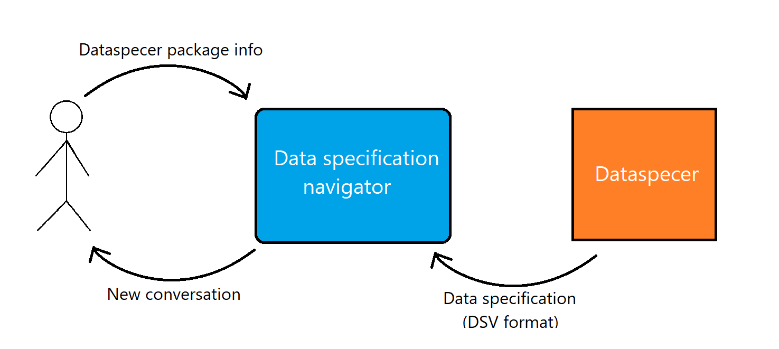
Input and output

Slide 6
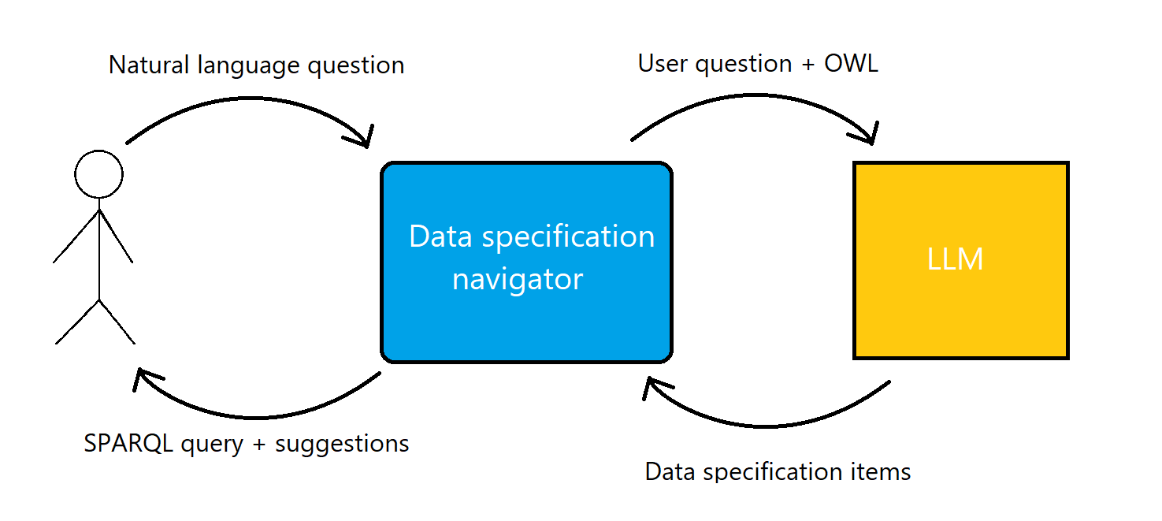
Input and output cont.

Slide 7
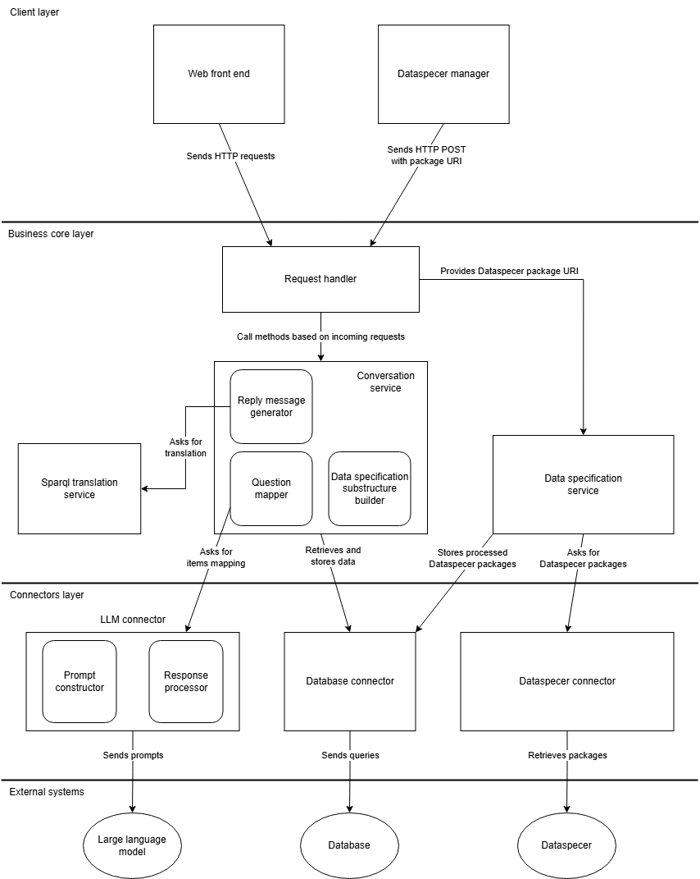
System Architecture

Slide 8





Technologies

Slide 9
Demo
Screenshots

Slide 10
Successfully implemented
DSV to OWL conversion.
Mapping concepts from natural language to data specifications.
SPARQL generation.
Suggestions for natural-language question.
Foundation for future extension and research.

